Slide 1
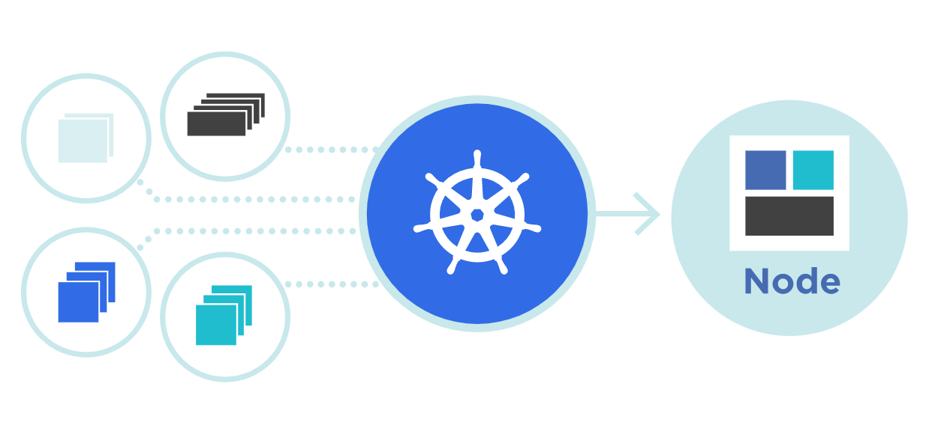



Kubernetes
Labels
&
Annotations
Theory + LAB + Documents ➔ All free
WATCH NOW
Notes:
Hello everyone. My name is Anish Rana and you are watching Kubernetes web series.

Slide 2
Kubernetes labels tagging methods
Labels
Annotations

Slide 3
Kubernetes labels tagging methods
Labels
What is Labels?
Benefit of using Labels?
Equality-based requirement
Set-based requirement
How to listing the labels?
Add / Update label on running object?
Deleting a label
Add a label to a node
LAB + EXAM
Annotations

Slide 4
Kubernetes labels tagging methods
Labels
Annotations
What is Annotation?
Attaching metadata to objects
Adding annotation on running object
How to delete Annotation
Lab for Labels & Annotations + Exam

Slide 5
01 NOW WE WILL TALK ABOUT
What is Labels?

Slide 6
Labels are key/value pairs that you can attach to your created objects, such as Pods.
These labels are attributes that will allow you to organize your objects in your Kubernetes cluster.
Labels can be attached to objects at creation time and subsequently added or modified at any time.
Labels are limited to 63 characters, should be short.
Start and end with an alphanumeric character (unless it’s empty),
Only include dashes (-), underscores (_), dots (.), and alpha numerics.

Slide 7
Once your objects have been labeled, you can list and query them using the labels they hold.
kubectl get pods --label "environment=production"
kubectl get pods -l "environment=production”
Example labels:
"release" : "stable", "release" : "canary"
"environment" : "dev", "environment" : "qa", "environment" : "production"
"tier" : "frontend", "tier" : "backend", "tier" : "cache"
"partition" : "customerA", "partition" : "customerB"
"track" : "daily", "track" : "weekly"

Slide 8
apiVersion: apps/v1
kind: Deployment
metadata:
name: env-deploy
labels:
app: env-deploy
release: stable
partition: customerA
spec:
replicas: 3
selector:
matchLabels:
app: env-deploy
matchExpressions:
- { key: release, operator: In, values: [stable] }
- { key: partition, operator: In, values: [customerA] }
- { key: environment, operator: NotIn, values: [dev] }
template:
metadata:
labels:
app: env-deploy
release: stable
partition: customerA
spec:
containers:
- name: env-cont
image: nginx
Set-based requirement

Slide 9
Agenda of this video.
What is Labels?
Benefit of using Labels?
Equality-based requirement
Set-based requirement
How to listing the labels?
Add / Update label on running object?
Deleting a label
Add a label to a node
LAB + EXAM

Slide 10
02 NOW WE WILL TALK ABOUT
Benefit of using Labels?

Slide 11





NS: frontent
NS: backend
NS: monit
NS: frontent
NS: backend
Environment: production
Environment: production
partition: customer-a
Environment: production
partition: customer-a
Environment: production
partition: customer-a
Environment: production
app-web
Environment: production
Graphana
app-redis
app-nginx
Maria-db
app-nginx
partition: customer-a
Environment: production
partition: customer-a
Prometheous
Environment: production
Environment: production
customer-a
customer-b
kubectl get pods -l "environment=production“
kubectl delete deployment,services,statefulsets -l "environment=production“
kubectl get pods -l "partition: customer-a“
Production

Slide 12
03 NOW WE WILL TALK ABOUT
Add / Update the label on running object?

Slide 13
kubectl label pods nginx-Pod release=stable
kubectl get pods nginx-Pod --show-labels
How to update the labels on existing pods?
kubectl label pods nginx-Pod release=canary --overwrite
kubectl get pods nginx-Pod --show-labels
kubectl get deploy -l "environment=production"
Using "kubectl label" command might be put you in the risk.

Slide 14
04 NOW WE WILL TALK ABOUT
Equality-based requirement

Slide 15
Equality- or inequality-based requirements allow filtering by label keys and values.
Three kinds of operators are admitted
For example:
environment = production
tier != frontend
environment=production,tier!=frontend
=
==
!=

Slide 16
05 NOW WE WILL TALK ABOUT
Set-based requirement

Slide 17
It allow filtering keys according to a set of values.
Three kinds of operators are supported in Kubernetes.
It is more expressive and accept OR operator on values.
Examples:
environment in (production, qa)
tier notin (frontend, backend)
partition
!partition
in
notin
exists

Slide 18
apiVersion: apps/v1
kind: Deployment
metadata:
name: env-deploy
labels:
app: env-deploy
release: stable
partition: customerA
spec:
replicas: 3
selector:
matchLabels:
app: env-deploy
matchExpressions:
- { key: release, operator: In, values: [stable] }
- { key: partition, operator: In, values: [customerA] }
- { key: environment, operator: NotIn, values: [dev] }
template:
metadata:
labels:
app: env-deploy
release: stable
partition: customerA
spec:
containers:
- name: env-cont
image: nginx
Set-based requirement

Slide 19
06 NOW WE WILL TALK ABOUT
How to listing the labels?

Slide 20
kubectl get pods --show-labels
kubectl get pods –l release=stable
kubectl get pods -l release=stable --output=wide

Slide 21
07 NOW WE WILL TALK ABOUT
Deleting a label

Slide 22
kubectl label nginx-pod release-
kubectl get pods --show-labels

Slide 23
08 NOW WE WILL TALK ABOUT
Add a label to a node

Slide 24
kubectl get nodes --show-labels
kubectl label nodes <your-node-name> disktype=ssd
kubectl label nodes workernode1.example.com disktype=ssd
kubectl get nodes --show-labels
Create a pod that gets scheduled to your chosen node
apiVersion: v1
kind: Pod
metadata:
name: nginx
labels:
env: test
spec:
containers:
- name: nginx
image: nginx
nodeSelector:
disktype: ssd

Slide 25
kubectl get nodes --show-labels
kubectl label nodes <your-node-name> disktype=ssd
kubectl label nodes workernode1.example.com disktype=ssd
kubectl get nodes --show-labels
Create a pod that gets scheduled to your chosen node
apiVersion: v1
kind: Pod
metadata:
name: nginx
labels:
env: test
spec:
containers:
- name: nginx
image: nginx
nodeSelector:
disktype: ssd
kubectl get pods --output=wide

Slide 26
Summary :
The more labeling you have in place, the easier it is to find precisely what you're looking for in Kubernetes.
Multiple teams using Kubernetes need to follow the same labeling conventions. Otherwise, all the labeling effort will bring you no value.
Don’t change labels often.

Slide 27
Kubernetes labels tagging methods
Labels
What is Labels?
Benefit of using Labels?
Equality-based requirement
Set-based requirement
How to listing the labels?
Add / Update label on running object?
Deleting a label
Add a label to a node
LAB + EXAM
Annotations

Slide 28
Kubernetes labels tagging methods
Labels
Annotations
What is Annotation?
Attaching metadata to objects
Adding annotation on running object
How to delete Annotation
Lab for Labels & Annotations

Slide 29
00 NOW WE WILL TALK ABOUT
Annotation

Slide 30
01 NOW WE WILL TALK ABOUT
What is Annotation?

Slide 31
Kubernetes annotations are the 2nd way of attaching metadata to the Kubernetes resources.
Annotations are very similar to labels, but the use cases are different.
Labels are used to identify resources and build relationships, however annotations are used to provide contextual information.
Labels are for Kubernetes, while annotations is for human.
Annotations are used for “non-identifying information” i.e., metadata that Kubernetes does not care about.

Slide 32
02 NOW WE WILL TALK ABOUT
Attaching metadata to objects

Slide 33
"metadata": {
"annotations": {
"key1" : "value1",
"key2" : "value2"
}
}
"metadata": {
“labels": {
"key1" : "value1",
"key2" : "value2"
}
}

Slide 34
03 NOW WE WILL TALK ABOUT
Adding annotation on running object

Slide 35
[root@master1 ~]# kubectl create deployment nginx --image=nginx --replicas=3
deployment.apps/nginx created
[root@master1 ~]# kubectl get deployments.apps
NAME READY UP-TO-DATE AVAILABLE AGE
nginx 3/3 3 3 25s
[root@master1 ~]# kubectl get deployments.apps nginx -o=json | jq .metadata.annotations
{
"deployment.kubernetes.io/revision": "1"
}
kubectl get deployments.apps nginx -o=jsonpath="{.metadata.annotations}" | jq
[root@master1 ~]# kubectl annotate deployment nginx "application=Nginx-web-server"
deployment.apps/nginx annotated
[root@master1 ~]# kubectl get deployments.apps nginx -o=json | jq .metadata.annotations
{
"application": "Nginx-web-server",
"deployment.kubernetes.io/revision": "1"
}

Slide 36
[root@master1 ~]# kubectl get deployments.apps nginx -o=json | jq .spec.template.metadata.annotations
null
[root@master1 ~]# kubectl patch deployment nginx -p '{"spec": {"template":{"metadata":{"annotations":{"pod/osversion":"12.0"}}}} }'
deployment.apps/nginx patched
[root@master1 ~]# kubectl get deployments.apps nginx -o=json | jq .spec.template.metadata.annotations
{
"pod/osversion": "12.0"
}

Slide 37
[root@master1 ~]# kubectl run webpod --image=nginx --annotations="OS/version=8.5"
pod/webpod created
[root@master1 ~]# kubectl get pods webpod -o=json | jq .metadata.annotations
{
"OS/version": "8.5",
"cni.projectcalico.org/containerID": "78c8043ee8f15e73f679d1596e89e323acdf757c2cd61ebfda74c2294f7e2733",
"cni.projectcalico.org/podIP": "172.16.133.142/32",
"cni.projectcalico.org/podIPs": "172.16.133.142/32"
}

Slide 38
04 NOW WE WILL TALK ABOUT
How to delete Annotation
Notes:
Now, we understand how to add the annotation in the object metadata and at pod level. In this topic, we will try to learn how to delete the annotation at metadata & pod level.

Slide 39
[root@master1 ~]# kubectl get deployments.apps nginx -o=json | jq .metadata.annotations
{
"application": "Nginx-web-server",
"deployment.kubernetes.io/revision": "2"
}
[root@master1 ~]# kubectl annotate deployments.apps nginx application-
deployment.apps/nginx annotated
[root@master1 ~]# kubectl patch deployments/nginx --type=json -p='[{"op": "remove", "path": "/metadata/annotations/application"}]'
deployment.apps/nginx patched
[root@master1 ~]# kubectl get deployments.apps nginx -o=json | jq .metadata.annotations
{
"deployment.kubernetes.io/revision": "2"
}
https://jsonpatch.com/
Notes:
Let’s check if we have annotation there in the metadata section.
Click, if we execute this command, by using json query “.metadata.annotation”, we get to know that we have two annotations.
Click, let’s remove application key annotation from there.
Click, In order to remove the annotation, we can use “kubectl annotate” command then object type after that object name and in the last we mention the annotation key name, in our case it is application with minus (-) sign. Same as it is we used for labels.
Click, another way is to use “kubectl patch” command by using “op”. “op” means operations and then use remove. Here, remove is a method.
Click, If you want to more information for how json patch work then, you may refer to this link.
In the last, we use path i.e. /metadata/annotations/application, that’s it.
Click, we can verify, by executing this command and we should observe this time only one annotation.

Slide 40
kubectl get deployments.apps nginx -o=json | jq .spec.template.metadata.annotations
{
"pod/osversion": "12.0"
}
kubectl patch deployments/nginx --type=json -p='[{"op": "remove", "path": "/spec/template/metadata/annotations/pod~1osversion"}]'
deployment.apps/nginx patched
[root@master1 ~]# kubectl get deployments.apps nginx -o=json | jq .spec.template.metadata.annotations
null
/ = ~1
Notes:
In this slide, I am going to show you how to remove the annotation at POD level.
Click, First, check if annotation is there at pod level. Yes, we have “pod/osversion” annotation is there.
Click, Lets delete this annotation by using “kubectl patch” command. Please, keep in mind that we have to use “tilde sign and then numeric 1 instead of “forward slash”.
Click, we can verify if our pod’s annotation is removed ?
Null ouput means there is no pod’s annotation.

Slide 41
03 NOW WE WILL TALK ABOUT
LAB + EXAM

